Slide 1

RETRIEVAL + ORCHESTRATION · DAY 7
01 / 28
••••••••••••
EMBEDDINGS · QDRANT · LANGGRAPH
RAG + LangGraph
The retrieval-augmented generation stack, end to end — from a raw PDF to a streaming chat answer your users can trust.
EMBEDDINGS
QDRANT
HYBRID SEARCH
INGESTION
LANGGRAPH
RAG + LANGGRAPH · PYTHON TRAINING
Notes:
Welcome to Day 7. Yesterday we shipped a backend that could answer slow questions. Today we teach it to answer questions it never saw before. RAG — retrieval-augmented generation. The model on its own only knows what it was trained on. RAG gives it a memory you control. We'll cover the embeddings that make retrieval possible, Qdrant as the vector store, the ingestion pipeline that fills it, and LangGraph as the orchestration layer that ties retrieval to generation. By the end you'll have a complete chat pipeline you can ship.

Slide 2
RAG + LANGGRAPH
02 / 28
••••••••••••
The session storyline
Each step builds on the previous one — from a single chunk of text to a streaming chat graph.
Embed
→
Store
→
Ingest
→
Search
→
Orchestrate
→
Chat
Text → vectors
Qdrant
Pipeline
Hybrid + filter
LangGraph
Capstone
Embeddings give meaning a coordinate.
A database designed for vectors.
Chunk, embed, attach metadata, upsert.
Dense meaning plus sparse keywords.
Stateful graph wires the steps together.
A grounded streaming chat pipeline.
RAG + LANGGRAPH · PYTHON TRAINING
Notes:
Storyline. We start with a model that doesn't know your data. We give it embeddings — numerical fingerprints of text. We put those fingerprints into Qdrant, a vector database. We design an ingestion pipeline that does this for every document. We design a search step that finds the right chunks for a question. And we orchestrate the whole thing — retrieve, generate, sometimes re-retrieve — using LangGraph. Each step builds on the previous one.

Slide 3
RAG + LANGGRAPH
03 / 28
••••••••••••
What we'll cover today
01
02
03
PART 01
PART 02
PART 03
RAG & Embeddings
Ingestion & Search
LangGraph Chat
Why retrieval beats fine-tuning · the Retrieve-Augment-Generate loop · what an embedding actually is · why the embedding model is a one-way door · Qdrant in one paragraph.
The five-stage ingestion pipeline · chunking knobs that move quality · payload design · dense, sparse, hybrid, and filtered search · the production default.
State, nodes, conditional edges · the rewrite-retrieve-grade-generate loop · compile and invoke · streaming the final node back through FastAPI.
RAG + LANGGRAPH · PYTHON TRAINING
Notes:
Three parts today. Part one — RAG foundations and embeddings — answers 'how does a vector store even know what's similar'. Part two — ingestion pipeline with Qdrant and the different search types — answers 'how do my documents get in there and how do I find the right ones'. Part three — LangGraph generation pipeline — answers 'how do I wire retrieval into a real chat loop'.

Slide 4
04 / 28
01
PART 01
RAG & Embeddings
The model doesn't know your data. Retrieval gives it a memory you control.
RAG + LANGGRAPH · PYTHON TRAINING
Notes:
Part one. The model doesn't know your data. RAG is the cheapest way to fix that — no fine-tuning, no retraining. You retrieve the relevant context at query time and stuff it into the prompt. The whole rest of today is the engineering around that one sentence.

Slide 5
RAG + LANGGRAPH
05 / 28
••••••••••••
The model doesn't know your data
RAG is the cheap fix — no retraining, knowledge you can update in seconds, citations you can audit.
FINE-TUNING
RAG
Bakes facts into model weights
Knowledge lives in a database, not weights
Hours to days per update — and a GPU bill
Update UPSERT a row — done in milliseconds
Drift is invisible until a user catches it
Every answer cites the chunks it used
No citations — can't show where an answer came from
Works with any model — swap providers freely
Best for style and format, not facts
The right tool for ~95% of enterprise use cases
RETRIEVE · AUGMENT · GENERATE — KEEP KNOWLEDGE OUTSIDE THE MODEL
RAG + LANGGRAPH · PYTHON TRAINING
Notes:
Why RAG, not fine-tuning. Fine-tuning bakes knowledge into the weights — expensive to do, expensive to update, and the model still hallucinates the parts that drifted. RAG keeps knowledge outside the model, in a database you can update in seconds, with citations you can audit. For 95% of enterprise use cases, RAG wins. Reserve fine-tuning for style and format, not for facts.

Slide 6
RAG + LANGGRAPH
06 / 28
••••••••••••
Retrieve · Augment · Generate
The model only ever sees the few hundred tokens that matter for this question.
USER
RETRIEVE
AUGMENT
GENERATE
Question
→
Top-k chunks from Qdrant
→
Stitch chunks into the prompt
→
Grounded answer + citations
Knowledge is external
Context, not corpus
Citations come free
The model doesn't memorise — it reads.
The model only sees what you stitched in.
Every chunk has an ID — you can show it.
RAG + LANGGRAPH · PYTHON TRAINING
Notes:
Retrieve, Augment, Generate. The user asks a question. We search a knowledge store for relevant chunks. We stitch those chunks into the prompt. The model answers using them. The model never sees your full corpus — only the few hundred tokens that matter for this specific question. That's the entire pattern. Everything else today is how to do each step well.

Slide 7
RAG + LANGGRAPH
07 / 28
••••••••••••
Vector embeddings — meaning as coordinates
A piece of text becomes a list of numbers. Texts with similar meaning end up close together.
THREE TEXTS → THREE VECTORS
DIMENSIONS
"Cancel my subscription"
Typically 768 or 1536 floats. More dims = finer distinctions, more storage.
"How do I unsubscribe?"
"Why is the sky blue?"
DISTANCE METRIC
The first two vectors look alike. The third doesn't. That's semantic similarity.
Cosine similarity for normalised vectors. Higher = more similar. Set this once on the collection.
THE WHOLE POINT
Search becomes nearest-neighbour lookup in vector space — fast, even at billions of points.
RAG + LANGGRAPH · PYTHON TRAINING
Notes:
Vector embeddings. A piece of text becomes a list of numbers — typically 768 or 1536 dimensions. Texts that mean similar things end up close together in that space. 'Cancel my subscription' and 'how do I unsubscribe' are far apart as strings but near each other as vectors. That distance is the entire mechanism of semantic search. Cosine similarity is the math; choosing the embedding model is the engineering.

Slide 8
RAG + LANGGRAPH
08 / 28
••••••••••••
The embedding model is a one-way door
Pick once. Use the same model at ingest and at query. Mixing models inside a collection breaks retrieval silently.
DIMENSIONALITY
QUALITY CEILING
LANGUAGE COVERAGE
SAME MODEL BOTH SIDES
Locked at collection creation. 768 for Gemini text-embedding-004 , 1536 for OpenAI text-embedding-3-small .
The model fixes how subtle a distinction retrieval can make. Above it, no amount of prompt tuning helps.
Multilingual or English-only? Code-aware? Domain-tuned (clinical, legal)? Match this to your corpus.
Embed query with the exact model used at ingest. A different model = a different space = junk results.
RAG + LANGGRAPH · PYTHON TRAINING
Notes:
Embedding models matter — a lot. The model fixes your dimensionality, your similarity behavior, your language coverage, and your ceiling on retrieval quality. You cannot mix embedding models inside one collection — every vector in a Qdrant collection must come from the same model. Picking one is a one-way door, so pick well. Today we'll use Google's text-embedding-004 via langchain-google-genai at 768 dims. Match the model at ingestion and at query — always.

Slide 9
RAG + LANGGRAPH
09 / 28
••••••••••••
Qdrant — the vector store
Rust-fast nearest-neighbour search, native payload filtering, the same image in Docker and in production.
COLLECTION
POINT
PAYLOAD
A namespace with a fixed vector config
One record: id + vector + payload
JSON metadata you filter on
Stable IDs let you upsert. Vectors hold meaning. Payload holds everything else.
document_id · tenant_id · timestamp · source_url · the chunk text itself.
Dimensionality · distance metric · HNSW index parameters. Set once. Cannot change without re-ingesting.
Open source
Fast at scale
Filter-native
Clean Python client
Self-host or managed — same API.
Sub-100ms at billions of points.
Boolean filters compose with vector search.
qdrant-client — sync & async.
RAG + LANGGRAPH · PYTHON TRAINING
Notes:
Qdrant — the vector store. An open-source vector database written in Rust. Stores vectors, stores payload metadata next to them, and runs approximate-nearest-neighbor search in milliseconds at billions-of-vectors scale. We use it because it's fast, has a clean Python client, supports payload filtering natively, and runs the same in Docker as in production. Three concepts to learn: collection — a namespace with a fixed vector configuration; point — one record with an ID, vector, and JSON payload; payload — the metadata you filter on at query time.

Slide 10
10 / 28
02
PART 02
Ingestion & Search
Most RAG projects succeed or fail at ingestion. Every stage has a knob.
RAG + LANGGRAPH · PYTHON TRAINING
Notes:
Part two — ingestion and search. Before you can retrieve, somebody had to put the data in. The ingestion pipeline is where most RAG projects succeed or fail. Bad chunks, wrong embeddings, missing metadata — you'll feel it every time a user asks a question. Let's design it deliberately, and then look at how Qdrant lets us search what we ingested.

Slide 11
RAG + LANGGRAPH
11 / 28
••••••••••••
The ingestion pipeline, end to end
Five stages from raw document to a queryable point in Qdrant — every stage has a knob that moves quality.
SOURCE
EXTRACT
CHUNK
EMBED
UPSERT
PDF · HTML Markdown · API
→
Raw text + structure
→
500–800 tok 10–15% overlap
→
Batch · same model both sides
→
Qdrant point + payload
Knob
Knob
Knob
Knob
Knob
Parser fidelity, OCR quality
Boundary rules, table handling
Chunk size, overlap, splitter
Batch size, retries, model choice
Payload schema, stable IDs
RAG + LANGGRAPH · PYTHON TRAINING
Notes:
The pipeline, end to end. Source documents come in — PDFs, HTML, Markdown, Confluence exports. We extract text. We chunk that text. We embed each chunk. We attach metadata. We upsert into Qdrant. Five stages, and every stage has a knob that affects retrieval quality. We'll talk about each knob.

Slide 12
RAG + LANGGRAPH
12 / 28
••••••••••••
Chunking — the single biggest quality lever
Too large dilutes meaning. Too small loses context. Get this right and the rest is gravy.
CHUNK SIZE
OVERLAP
NATURAL BOUNDARIES
SPECIAL CONTENT
Aim for 500–800 tokens . Measured in tokens , not characters — a tokenizer-aware splitter is non-negotiable.
10–15% overlap between adjacent chunks. Stops a sentence from being orphaned at the boundary.
Split on paragraph, heading, then sentence — never mid-sentence. Markdown structure beats blind length.
Code blocks and tables stay whole. Don't shred a function or a row across chunks — it kills retrieval.
RAG + LANGGRAPH · PYTHON TRAINING
Notes:
Chunking — the single biggest quality lever. Chunks too large: irrelevant text dilutes the embedding. Chunks too small: the model loses context. Production defaults: 500–800 tokens per chunk, 10–15 percent overlap between adjacent chunks, split on natural boundaries — sentence, paragraph, markdown heading — never mid-sentence. Use a tokenizer-aware splitter; character count lies about token count.

Slide 13
RAG + LANGGRAPH
13 / 28
••••••••••••
Payload — metadata is what makes search useful
Filters and vector search compose. Plan your payload before you ingest a single document.
# the shape of one Qdrant point {
"id": "doc-4f2a__chunk-007" ,
"vector": [0.012, -0.341, 0.207, ... 768 floats ],
"payload" : {
"document_id": "doc-4f2a" ,
"chunk_index": 7 ,
"tenant_id": "acme-corp" ,
"source_url": "https://kb.acme/q3-financials.pdf" ,
"timestamp": "2025-10-14T09:31:00Z" ,
"section_title": "Q3 Revenue Breakdown" ,
"language": "en" ,
"text": "Total revenue grew 14% YoY, driven by..." }
}
STABLE IDS
document_id + chunk_index — re-ingestion upserts in place.
TENANT ISOLATION
Every query MUST filter on tenant_id . Multi-tenant safety starts here.
RECENCY & SCOPE
Filter by timestamp or doc_type — Q3 questions shouldn't see Q1 chunks.
TEXT LIVES HERE
RAG + LANGGRAPH · PYTHON TRAINING
Store the chunk text in the payload. Qdrant returns it on search — one round-trip.
Notes:
Metadata is what makes search useful. Every chunk gets a payload. At minimum: document_id, chunk_index, source_url, timestamp, tenant_id. Add domain-specific fields liberally: language, page_number, section_title, doc_type. You filter on these at query time. A user asking about Q3 financials shouldn't see Q1 chunks just because they're embedding-similar. Filters fix that. Plan your payload before you ingest a single document.

Slide 14
RAG + LANGGRAPH
14 / 28
••••••••••••
Ingestion — chunk, batch-embed, upsert
One HTTP call per 100 chunks, stable IDs for clean re-ingest, payload attached at write time.
BATCH EMBEDDINGS
One call per ~100 chunks. Per-chunk calls will quietly bankrupt you.
# ingest/pipeline.py
from langchain_text_splitters import RecursiveCharacterTextSplitter
from langchain_google_genai import GoogleGenerativeAIEmbeddings
from qdrant_client import QdrantClient, models
splitter = RecursiveCharacterTextSplitter(chunk_size=3000, chunk_overlap=400)
embedder = GoogleGenerativeAIEmbeddings(model="models/text-embedding-004")
qdrant = QdrantClient(url=QDRANT_URL, api_key=QDRANT_KEY)
def ingest_document(doc_id: str, text: str, meta: dict):
chunks = splitter.split_text(text)
vectors = embedder.embed_documents(chunks) # batched HTTP
points = [
models.PointStruct(
id=f"{doc_id}__chunk-{i:04d}", # stable → upsert-safe
vector=v,
payload={**meta, "chunk_index": i, "text": c},
)
for i, (c, v) in enumerate(zip(chunks, vectors))
]
qdrant.upsert(collection_name="kb", points=points, wait=True)
STABLE POINT ID
doc_id + chunk_index — re-running the pipeline upserts cleanly.
PAYLOAD AT WRITE
No separate document store. Qdrant returns the text on search.
WAIT = TRUE
For ingest jobs you want the write durable before returning.
RAG + LANGGRAPH · PYTHON TRAINING
Notes:
The ingestion code. langchain-text-splitters for chunking, langchain-google-genai for Gemini embeddings, qdrant-client for the upsert. Three things to notice. We batch embeddings — one HTTP call per 100 chunks, not one per chunk. We use a stable point ID derived from document_id plus chunk_index, so re-ingesting the same document upserts cleanly. We attach the full chunk text into the payload — Qdrant returns it on search; we don't need a separate document store.

Slide 15
RAG + LANGGRAPH
15 / 28
••••••••••••
Four search modes in Qdrant
Dense alone misses acronyms. Sparse alone misses paraphrase. Hybrid plus filters is the production default.
DENSE
SPARSE
HYBRID
FILTERED
Embedding similarity. Catches meaning — paraphrases, synonyms, intent. Misses rare exact tokens.
BM25-style lexical match (e.g. SPLADE). Catches exact strings — CVEs, error codes, product SKUs, names.
Run both in one request. Qdrant fuses scores with RRF and returns one ranked list. The production default.
Compose any of the above with a payload Filter . Tenant, date range, doc type — narrow first, then rank.
RAG + LANGGRAPH · PYTHON TRAINING
Notes:
Search in Qdrant — four modes you should know. Dense vector search — the embedding similarity we've been describing. Sparse vector search — BM25-style lexical match, captures exact keywords and proper nouns that embeddings smudge. Hybrid — run both, fuse the scores. Filtered — combine vector or hybrid with a payload predicate. Production RAG almost always uses hybrid plus filters. Dense alone misses acronyms; sparse alone misses paraphrase. Let me show you why on the next slide.

Slide 16
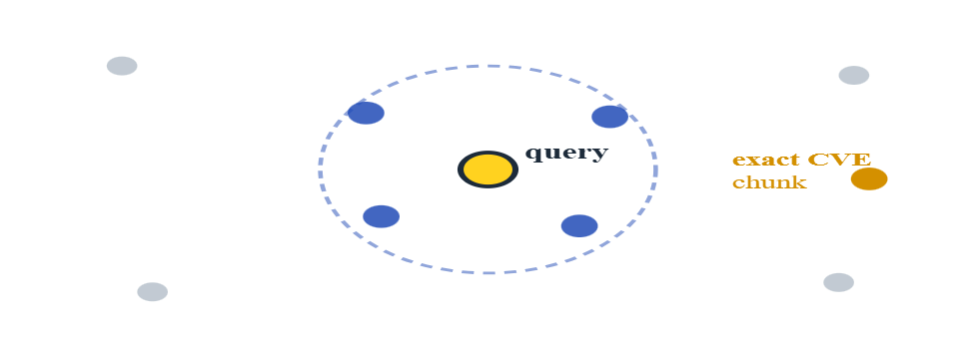
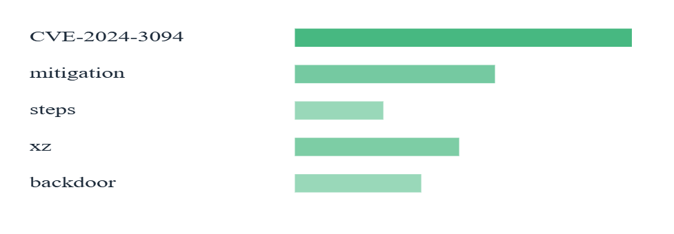
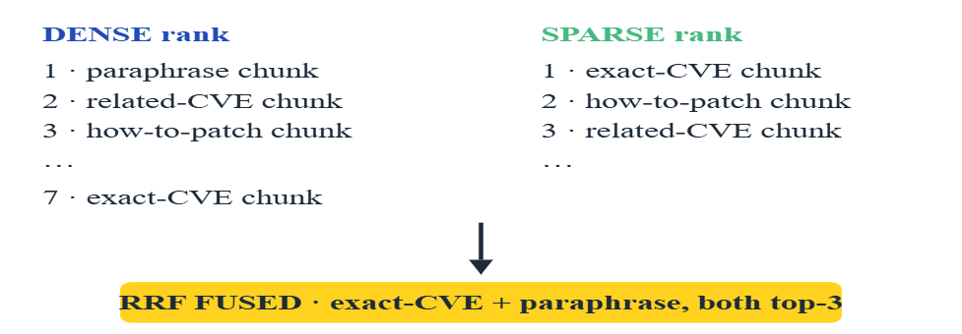
RAG + LANGGRAPH
16 / 28
••••••••••••
Dense vs sparse vs hybrid — and why we pick hybrid
Query: "CVE-2024-3094 mitigation steps" — meaning and an exact token. Watch what each retriever does.
DENSE · SEMANTIC
SPARSE · LEXICAL (BM25)
HYBRID · DENSE + SPARSE + RRF
Vectors in space. The query lands near paraphrases of "mitigation". The exact CVE string sits outside the ring — meaning was caught, the keyword was missed.
Exact-token match. The rare CVE string scores very high. But "mitigation" loses to a paraphrased chunk that says "remediation" — meaning was lost.
Run both, fuse the ranks. Chunks that win on either signal bubble up. The exact CVE and the paraphrased mitigation both end up in the top-k.
PICK HYBRID · MEANING CATCHES PARAPHRASE · KEYWORDS CATCH RARE TOKENS · RRF NEEDS NO TUNING
RAG + LANGGRAPH · PYTHON TRAINING
Notes:
Here's why hybrid wins, made visual. Take the query 'CVE-2024-3094 mitigation steps' — it has meaning (how do I patch this) AND an exact rare token (the CVE number). Look at dense, on the left. The query vector lands near paraphrases of 'mitigation' in vector space — but the chunk that actually mentions the CVE string sits far away. Meaning caught, keyword missed. Look at sparse, in the middle. The exact CVE string scores very high — but 'mitigation' loses to a paraphrased chunk that says 'remediation' instead. Keyword caught, meaning missed. Look at hybrid, on the right. We run both, get two ranked lists, and fuse them with Reciprocal Rank Fusion — RRF. Anything that won on either signal bubbles up. The exact CVE chunk AND the paraphrased mitigation chunk both end up in the top-k. That's why hybrid is the production default — meaning catches paraphrase, keywords catch rare tokens, RRF doesn't need score calibration. The cost is one extra index at ingest time. Worth it.

Slide 17
RAG + LANGGRAPH
17 / 28
••••••••••••
Hybrid search — one request, two indexes, fused scores
"CVE-2024-3094 mitigation" needs meaning and the exact CVE string. Hybrid gives you both.
# search/hybrid.py
from qdrant_client import models
def hybrid_search(query: str, tenant_id: str, k: int = 8):
dense = dense_embedder.embed_query(query)
sparse = sparse_embedder.embed_query(query)
return qdrant.query_points(
collection_name="kb",
prefetch=[
models.Prefetch(query=dense, using="dense", limit=30),
models.Prefetch(query=sparse, using="sparse", limit=30),
],
query=models.FusionQuery(fusion=models.Fusion.RRF),
query_filter=models.Filter(
must=[models.FieldCondition(
key="tenant_id",
match=models.MatchValue(value=tenant_id),
)]
),
limit=k,
with_payload=True
).points
TWO PREFETCHES
Dense and sparse run in parallel inside Qdrant. One round-trip from your app.
RRF FUSION
Reciprocal Rank Fusion — robust score-merging that doesn't need calibration.
FILTER IS MANDATORY
Tenant filter on every query. Forget it once, you leak across customers.
PAYLOAD RETURNED
with_payload=True — you get the chunk text inline, ready to stitch into the prompt.
RAG + LANGGRAPH · PYTHON TRAINING
Notes:
Hybrid search code. We embed the query twice — once with the dense model, once with a sparse model. We hand Qdrant two prefetches in one request; it runs them in parallel internally. We tell it to fuse the results with RRF. We attach a tenant filter — that filter is non-negotiable; forget it once and you leak across customers. With payload set to true, the chunk text comes back inline, ready to stitch into the prompt.

Slide 18
18 / 28
03
PART 03 · CAPSTONE
LangGraph Chat Pipeline
State · nodes · conditional edges — wire retrieval and generation into a real graph.
RAG + LANGGRAPH · PYTHON TRAINING
Notes:
Part three — LangGraph. We now have retrieval. We need generation. We need a way to wire them — and to handle the messy parts: re-retrieval when the answer is weak, tool calls, follow-up clarification, memory across turns. LangGraph is the orchestration layer that makes that wiring explicit.

Slide 19
RAG + LANGGRAPH
19 / 28
••••••••••••
LangGraph — stateful LLM applications as a graph
A state machine where the transitions are Python, the state is typed, and every step is traceable.
STATE
NODES
EDGES
A typed dict that flows through the graph. Question, retrieved docs, messages, attempts, answer — all live here.
Plain Python functions: state in, state-patch out . No framework lock-in — callable in a unit test.
Static edges connect nodes. Conditional edges branch on the state — that's how you loop, retry, escalate.
COMPILE ONCE · INVOKE PER REQUEST · EVERY STEP TRACEABLE IN LANGSMITH
RAG + LANGGRAPH · PYTHON TRAINING
Notes:
What LangGraph is. A library for building stateful, multi-step LLM applications as a graph. State is a typed dict that flows through the graph. Nodes are pure functions: state in, state-patch out. Edges connect nodes; conditional edges branch based on the state. Compile the graph once at startup. Invoke it per request. Every step shows up in LangSmith — you can trace which node ran, what state it produced, how long it took.

Slide 20
RAG + LANGGRAPH
20 / 28
••••••••••••
A RAG chat graph — five nodes, one loop
Rewrite the follow-up · retrieve from Qdrant · grade the chunks · generate — or loop back if the grade fails.
START
→
NODE
→
NODE
→
NODE
→
Generate
User turn
Rewrite
Retrieve
Grade
END
if grade = "weak" → refine question → retrieve again
↻ conditional edge
REWRITE
RETRIEVE
GRADE
LOOP
GENERATE
Standalone question from history.
Hybrid Qdrant search + tenant filter.
Model judges chunk relevance.
Refine and re-retrieve up to N times.
Stream tokens back to the client.
RAG + LANGGRAPH · PYTHON TRAINING
Notes:
A RAG chat graph. Five nodes. Rewrite — turn the user's follow-up into a standalone question. Retrieve — hybrid Qdrant search with the tenant filter. Grade — let the model decide whether the retrieved chunks are good enough to answer. Generate — answer using the chunks. Or, if grade said no, loop back to rewrite with a refined question. One conditional edge does the looping. This is the shape of every production RAG chat system worth its salt.

Slide 21
RAG + LANGGRAPH
21 / 28
••••••••••••
State — the vocabulary every node speaks
Annotated channels merge across nodes; plain fields overwrite. Define once, reuse everywhere.
# graph/state.py
from typing import Annotated, TypedDict
from langchain_core.messages import BaseMessage
from langgraph.graph.message import add_messages
class ChatState(TypedDict):
tenant_id: str
question: str # raw user turn
rewritten: str # standalone form
documents: list[dict] # Qdrant chunks
grade: str # "good" | "weak"
attempts: int # for loop cap
messages: Annotated[list[BaseMessage], add_messages]
answer: str # final streamed text
TYPED CHANNELS
LangGraph reads the hints to know which fields are managed state.
ADD_MESSAGES REDUCER
Each node returns new messages; LangGraph appends — never lose history.
ATTEMPTS CAP
One field stops the retry loop running forever.
TENANT ON STATE
Carried into every retrieval call — no node forgets the filter.
RAG + LANGGRAPH · PYTHON TRAINING
Notes:
The state schema. A TypedDict — tenant_id, question, rewritten, documents, grade, attempts, messages, answer. LangGraph reads the type hints to know which fields are 'channels' it should manage. Annotated fields with a reducer — like add_messages — get merged across nodes so history accumulates; plain fields get overwritten. Define state once at the top of the file; every node speaks this vocabulary.

Slide 22
RAG + LANGGRAPH
22 / 28
••••••••••••
Retrieve node — a function, nothing more
State in. State-patch out. Callable in a unit test without LangGraph anywhere near it.
# graph/nodes/retrieve.py
from .state import ChatState
from search.hybrid import hybrid_search
def retrieve(state: ChatState) -> dict:
hits = hybrid_search(
query=state["rewritten"],
tenant_id=state["tenant_id"],
k=8
)
docs = [
{
"id": h.id, "text": h.payload["text"],
"source": h.payload["source_url"],
"score": h.score
}
for h in hits
]
return {"documents": docs} # patch — only this field
PURE FUNCTION
No globals, no framework imports. The graph just sequences these calls.
RETURNS A PATCH
Only the keys you change. LangGraph merges with current state.
READS REWRITTEN
Always search the standalone question — never the raw last turn.
TENANT ALWAYS
Tenant filter is enforced inside hybrid_search.
RAG + LANGGRAPH · PYTHON TRAINING
Notes:
The retrieve node. Takes the rewritten question off state, runs a hybrid Qdrant search with the tenant filter, returns the top-k chunks as state.documents. Notice — the node is just a function. No magic. No framework lock-in. You can call it standalone in a test. LangGraph just sequences calls to functions like this.

Slide 23
RAG + LANGGRAPH
23 / 28
••••••••••••
Generate node — grounded, cited, streamed
The model is told to answer only from the chunks — and to refuse if they don't cover the question.
GROUNDED PROMPT
# graph/nodes/generate.py
from langchain_google_genai import ChatGoogleGenerativeAI
from langchain_core.messages import SystemMessage, HumanMessage
from .state import ChatState
llm = ChatGoogleGenerativeAI(
model="gemini-2.0-flash", temperature=0, disable_streaming=False,
)
SYSTEM = """Answer using ONLY the context. Cite each fact as [doc-id]. If the context is insufficient, say so plainly — do not guess."""
def generate(state: ChatState) -> dict:
context = "\n\n".join(f"[{d['id']}] {d['text']}" for d in state["documents"])
msg = [
SystemMessage(content=SYSTEM),
*state["messages"],
HumanMessage(content=f"Question: {state['rewritten']}\n\nContext:\n{context}"),
]
reply = llm.invoke(msg)
return {"messages": [reply], "answer": reply.content}
"Only from context" + citations. Hallucinations drop hard.
HISTORY IN PROMPT
Full chat messages flow in — the model can follow references.
REFUSE GRACEFULLY
If context is thin, the model says so — better than confident wrong.
STREAMING-READY
langchain-google-genai streams Gemini tokens — pipe through FastAPI to the client.
RAG + LANGGRAPH · PYTHON TRAINING
Notes:
The generate node. We use ChatGoogleGenerativeAI from langchain-google-genai — same provider as our embeddings, one API key, one rate-limit bucket. The system prompt is the safety net: 'answer using ONLY the context, cite each fact, refuse if context is thin'. Hallucinations drop hard with that one sentence. We pass the full message history so the model can resolve references like 'and what about Q4'. Streaming is on — tokens flow through FastAPI to the client as they're produced.

Slide 24
RAG + LANGGRAPH
24 / 28
••••••••••••
Compile the graph — then invoke per request
Static edges wire the spine. One conditional edge decides whether to loop.
# graph/build.py
from langgraph.graph import StateGraph, START, END
from .state import ChatState
from .nodes import rewrite, retrieve, grade, generate
def route_after_grade(state: ChatState) -> str:
if state["grade"] == "good" or state["attempts"] >= 2:
return "generate"
return "rewrite"
g = StateGraph(ChatState)
g.add_node("rewrite", rewrite)
g.add_node("retrieve", retrieve)
g.add_node("grade", grade)
g.add_node("generate", generate)
g.add_edge(START, "rewrite")
g.add_edge("rewrite", "retrieve")
g.add_edge("retrieve", "grade")
g.add_conditional_edges("grade", route_after_grade, {
"generate": "generate", "rewrite": "rewrite"
})
g.add_edge("generate", END)
chat_graph = g.compile() # reuse across requests
COMPILE ONCE
App-startup work. Compilation is cheap; reuse the graph instance.
CONDITIONAL EDGE
A router function returns the name of the next node — that's the whole loop.
LOOP CAP
attempts >= 2 forces an answer even if the grade is still weak.
FASTAPI HANDLER
RAG + LANGGRAPH · PYTHON TRAINING
chat_graph.invoke({...}) or .astream() from your endpoint.
Notes:
Compile and invoke. StateGraph constructor takes the state type. add_node attaches each function. add_edge wires the static spine. add_conditional_edges wires the grade-decides-next-step branch with a router function that returns the name of the next node. compile() returns a runnable. The attempts cap is critical — without it, a perpetually weak grade would loop forever. You invoke the compiled graph from your FastAPI handler.

Slide 25
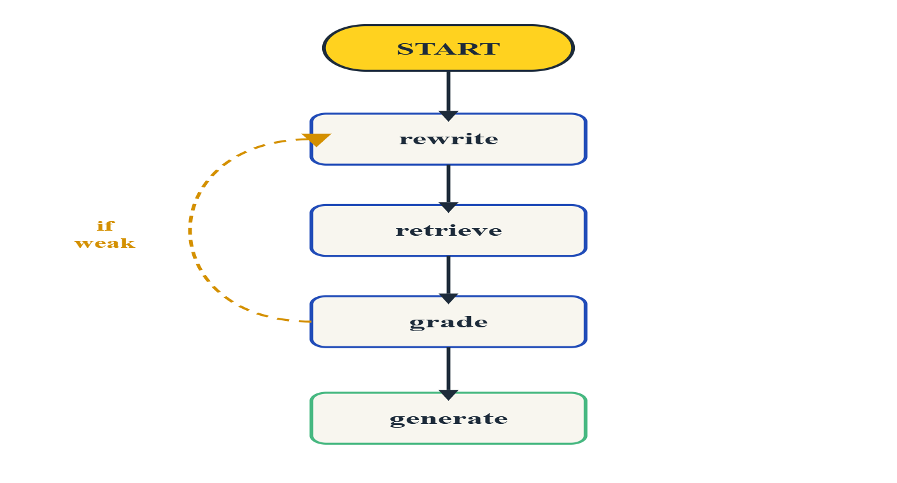
RAG + LANGGRAPH
25 / 28
••••••••••••
Visualize the graph — export it as a PNG
LangGraph renders the compiled graph via Mermaid. Commit the PNG with your code — it's the cheapest architecture diagram you'll ever own.
# scripts/draw_graph.py
from pathlib import Path
from graph.build import chat_graph
# 1) Get the underlying graph object
graph = chat_graph.get_graph()
# 2) ASCII — handy for terminals & PRs
print(graph.draw_ascii())
# 3) PNG via Mermaid
png_bytes: bytes = graph.draw_mermaid_png()
Path("docs/chat_graph.png").write_bytes(png_bytes)
# 4) Or just dump the Mermaid source
Path("docs/chat_graph.mmd").write_text(graph.draw_mermaid())
DOCS/CHAT_GRAPH.PNG
DRAW_ASCII
DRAW_MERMAID_PNG
DRAW_MERMAID
RUN IN CI
For terminals and PR descriptions.
Bytes — write to docs/, commit.
Source — renders in any wiki.
Regenerate on every graph change.
RAG + LANGGRAPH · PYTHON TRAINING
Notes:
Visualize the graph. LangGraph can render the compiled graph for you. Three options. draw_ascii — handy in a terminal or a pull-request description. draw_mermaid_png — returns PNG bytes you write to a file; uses mermaid.ink by default but you can wire it to a local Mermaid renderer in air-gapped environments. draw_mermaid — gives you the source so your wiki can render it server-side. The habit to form is: run this script in CI, commit the PNG to docs/, and now every code review of a graph change shows the new shape in the diff. It's the cheapest architecture diagram you'll ever own — and it can't drift, because it's generated from the real graph.

Slide 26
RAG + LANGGRAPH
26 / 28
••••••••••••
The full chat-turn lifecycle
Rewrite to first streamed token in under two seconds — and a citation trail for every fact.
t = 0
t = 50 ms
t = 150 ms
t = 300 ms
t = 1.5 s
t = 3 s
User sends turn
Rewrite returns
Hybrid search
Grade returns
First token
Answer complete
follow-up question
standalone question
top-8 chunks from Qdrant
2 chunks dropped - still good
streaming begins
messages persisted
REWRITE · RETRIEVE · GRADE · GENERATE — EVERY STEP TRACEABLE
RAG + LANGGRAPH · PYTHON TRAINING
Notes:
The full request lifecycle. T=0, user sends a follow-up. T=50 ms, rewrite returns a standalone question. T=150 ms, hybrid Qdrant search returns the top eight chunks. T=300 ms, the grader rejects two of them — still enough to answer. T=1.5 s, generate streams the first token. T=3 s, the answer is done, the messages and documents are persisted. The user saw streaming tokens after one and a half seconds. This is the shape.

Slide 27
RAG + LANGGRAPH
27 / 28
••••••••••••
Production checklist — RAG + LangGraph
Four habits that separate a demo-day RAG bot from one your customers can rely on.
SAME EMBEDDING MODEL
TENANT FILTER, ALWAYS
EVAL YOUR RETRIEVAL
CAP THE LOOP
Pin the model in config. Embed at ingest and at query with the exact same version. Treat upgrades as re-ingests.
Wrap retrieval so it cannot be called without a tenant_id. Multi-tenant leaks start with one forgotten filter.
A small golden set of (question, expected-doc) pairs. Measure recall@k on every change to chunking, model, or filters.
Conditional edges can spin forever. Every loop needs an attempts cap and a graceful "I don't know" exit.
RAG + LANGGRAPH · PYTHON TRAINING
Notes:
Production checklist. Four habits. One: pin the embedding model in config and treat any upgrade as a re-ingest — never mix versions in one collection. Two: tenant filter on every retrieval call, enforced inside the search function so no node can forget it. Three: have a small golden set of question-and-expected-doc pairs and measure recall on every change to chunking, model, or filters. Four: every loop needs a cap and a graceful 'I don't know' exit — conditional edges can spin forever otherwise.

Slide 28
RAG + LANGGRAPH
28 / 28
••••••••••••
Knowledge check
01
Once you pick an embedding model for a collection, why can't you switch it later without re-ingesting all your data?
02
Give an example of a question where searching by meaning alone (dense) misses the right answer — and explain how adding keyword search (sparse) fixes it.
03
What is the payload on a Qdrant point, and what's one thing it lets you do that a vector alone cannot?
04
In LangGraph, a normal edge always goes to the same next node. What does a conditional edge do differently — and why do we need one to build a retry loop?
05
If a user asks "and what about Q4?" as a follow-up, why should we rewrite the question before searching, instead of sending it to Qdrant as-is?
RAG + LANGGRAPH · PYTHON TRAINING
Notes:
Knowledge check. Five questions. Same drill as yesterday — think first, then we talk through them. Question one and question four are the ones that catch people; if you can answer those, you've understood today.

Slide 29


RAG + LANGGRAPH
••••••••••••
Thank You
Happy Coding & Building Robust RAG Systems
RAG + LANGGRAPH · PYTHON TRAINING

